Slide 1

AI FOR IMPACT
AI Resume-to-Job Fit Analyzer
Empowering job seekers with intelligent, AI-driven skill-gap analysis and resume matching.
Rahi Prajapat
Musta Abda Bhaiwala
CodeVerse

Slide 2


PROBLEM STATEMENT
The Employability Gap Nobody Talks About
Job seekers submit dozens of applications with no feedback. Recruiters spend hours manually screening resumes. Both sides lose.
The Core Problem
There is no intelligent, automated tool that analyzes a resume against a job description and tells candidates exactly what skills they are missing.
Our Solution
An AI Resume-to-Job Fit Analyzer that reads a resume, compares it to a job description, and generates a detailed skill-gap report with compatibility scoring.

Slide 3
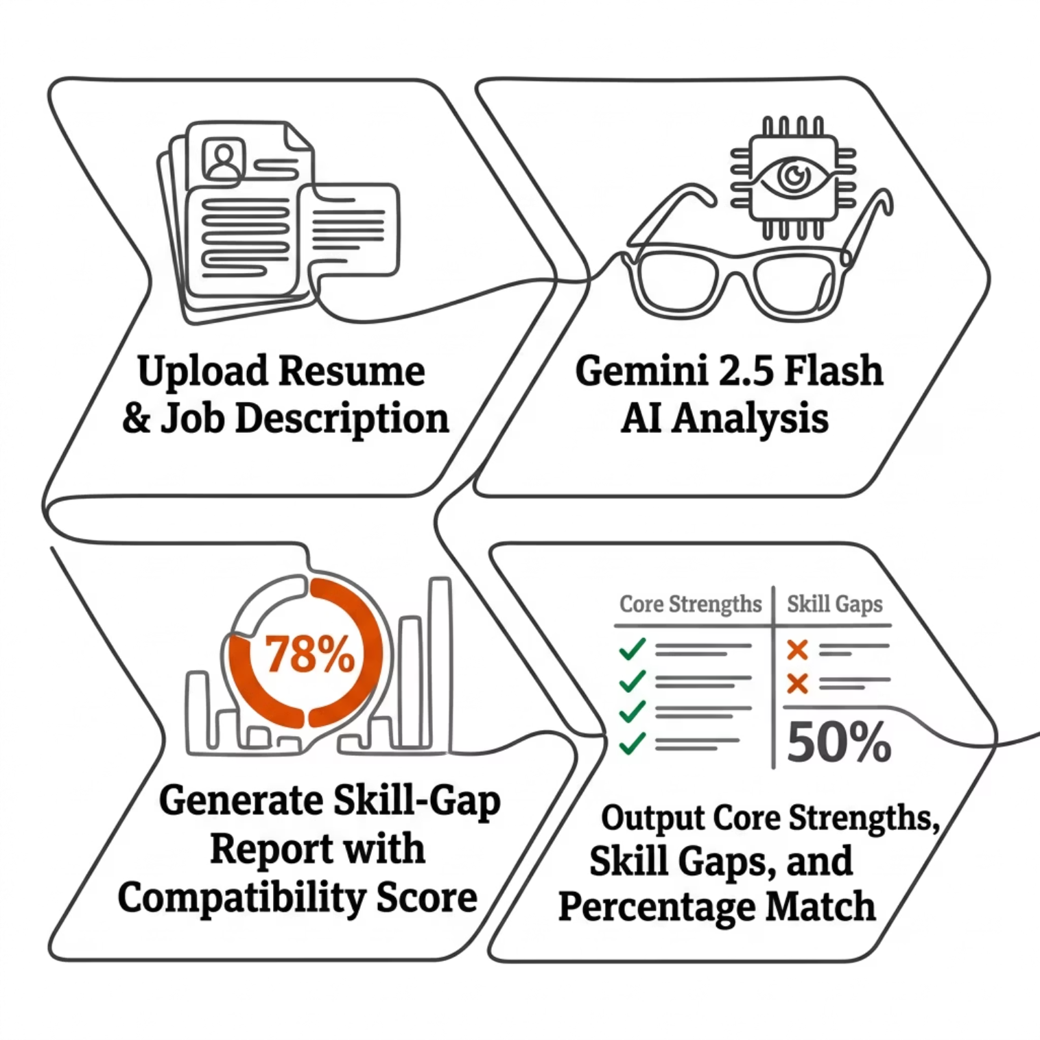

HOW IT WORKS
Powered by Gemini 2.5 Flash
What Gemini 2.5 Flash Delivers
Resume Shortlisting: AI ranks and filters candidates automatically
Core Strengths: Highlights the candidate's strongest matching skills
Skill Gaps: Identifies missing or weak competencies vs. job requirements
Compatibility Score: A clear percentage match between resume and job description
Gemini 2.5 Flash provides fast, accurate, and context-aware natural language understanding for precise matching.

Slide 4
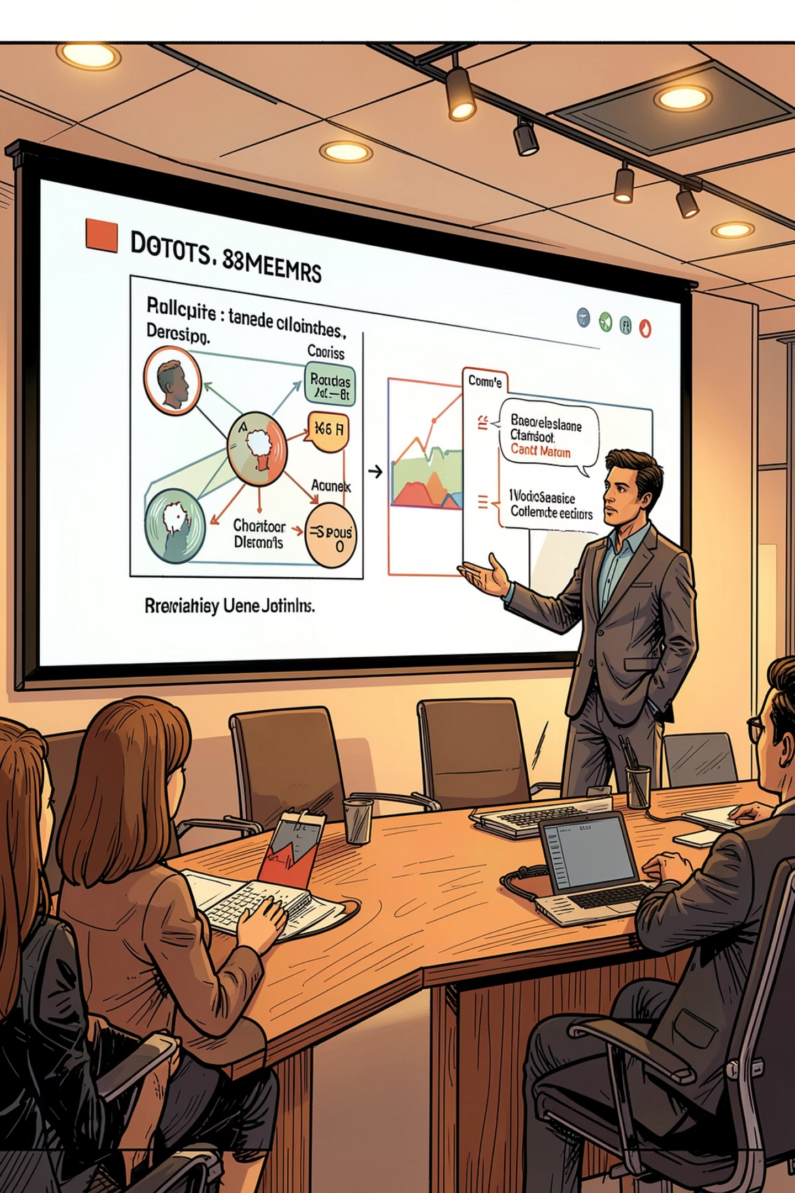

LIVE DEMO
See It in Action
Watch how the AI Resume-to-Job Fit Analyzer processes a real resume, compares it to a live job description, and generates an instant skill-gap report with a compatibility percentage.
▶ Video Placeholder — Demo video will be embedded here. The walkthrough covers resume upload, AI analysis, and the final skill-gap report output.

Slide 5

Thank You
We believe AI can bridge the gap between talent and opportunity — one resume at a time.
🎯 Problem Solved
⚡ Tech Stack
Automated, intelligent resume-to-job matching with actionable feedback
Powered by Google Gemini 2.5 Flash for fast, accurate AI analysis
🌍 Impact
Helps job seekers improve employability and recruiters hire smarter
Team Name — Built for AI for Impact Hackathon

